Slide 1



Quiz Website
Project
Presented by: Arup Ranjan Dalai (2005575)

Slide 2


Overview
Introduction
Project Structure
HTML Structure
CSS Styling
JavaScript Implementation
Summary and Future Work
Thank You

Slide 3
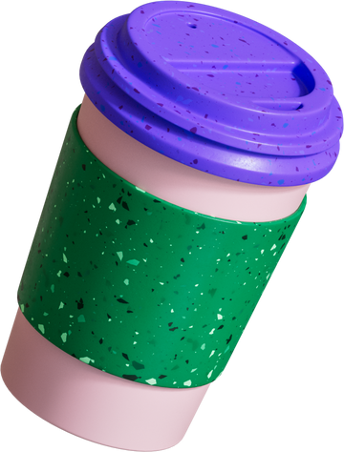
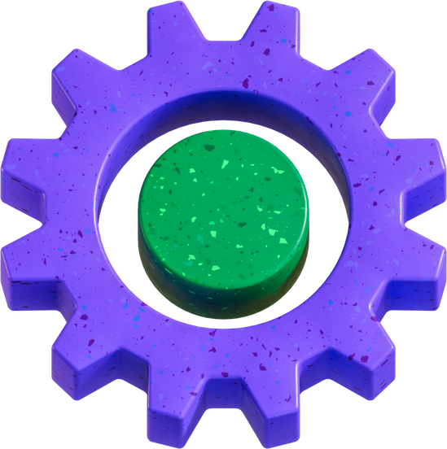

Introduction
Quiz Website is an HTML, CSS, and JavaScript app that tests knowledge with instant feedback. Questions, options, and result updates are dynamic.

Slide 4
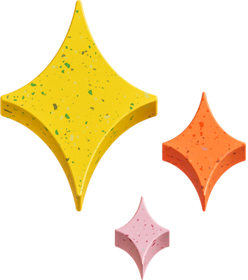





Project Structure
Project has 3 main components: HTML, CSS, JavaScript. HTML is webpage structure with `<head>` and `<body>`. `<body>` uses `<div>` with class names to define sections. CSS adds design and JavaScript handles quiz dynamics.
HTML
Hypertext Markup Language
CSS
Cascanding Style Sheet
JS
Java Script

Slide 5
HTML Structure
The `quiz website.html` HTML file has a standard structure with a `<head>` and `<body>` section. In the `<body>`, `<div>` elements with specific class names structure the website into question, option, result display, and navigation sections.

Slide 6
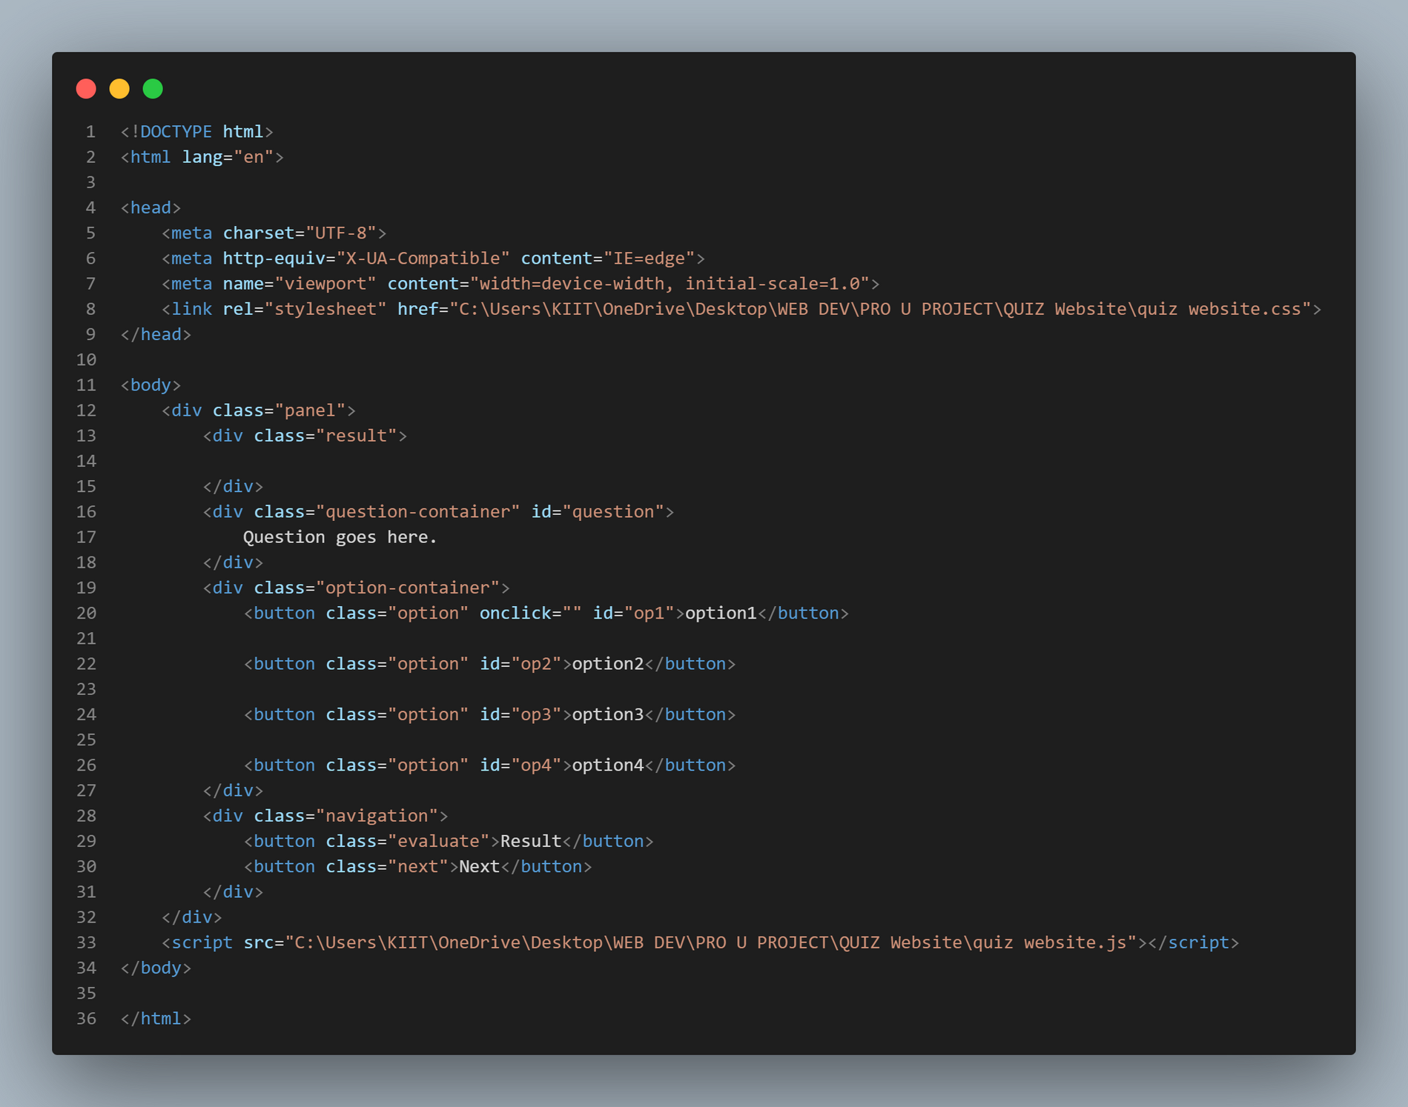
HTML CODE

Slide 7
CSS Styling
The `quiz website.css` file styles the quiz website, controlling colors, spacing, font size, and borders. This creates an attractive and easy-to-use interface.

Slide 8
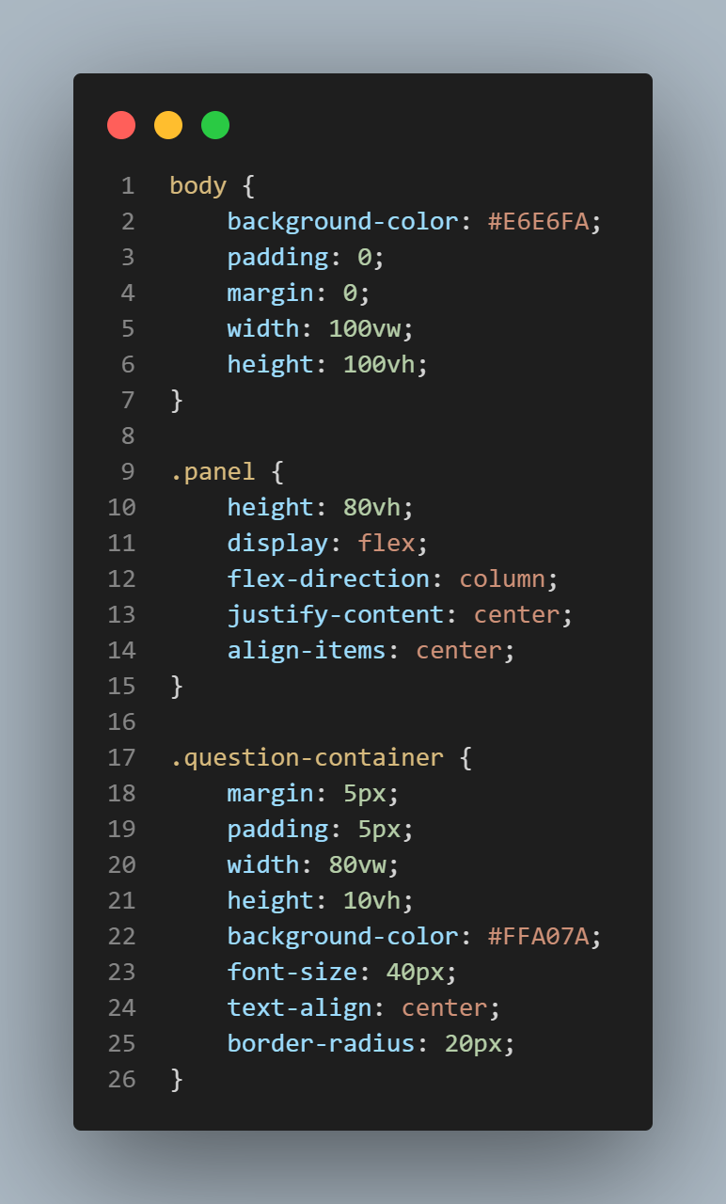
CSS CODE

Slide 9
JavaScript Implementation
`quiz website.js` makes a dynamic quiz website. It uses objects to store questions, options, and correctness. `iterate()` updates content, evaluates user selections, and tracks option selection. The "Next" button iterates to the next question.

Slide 10
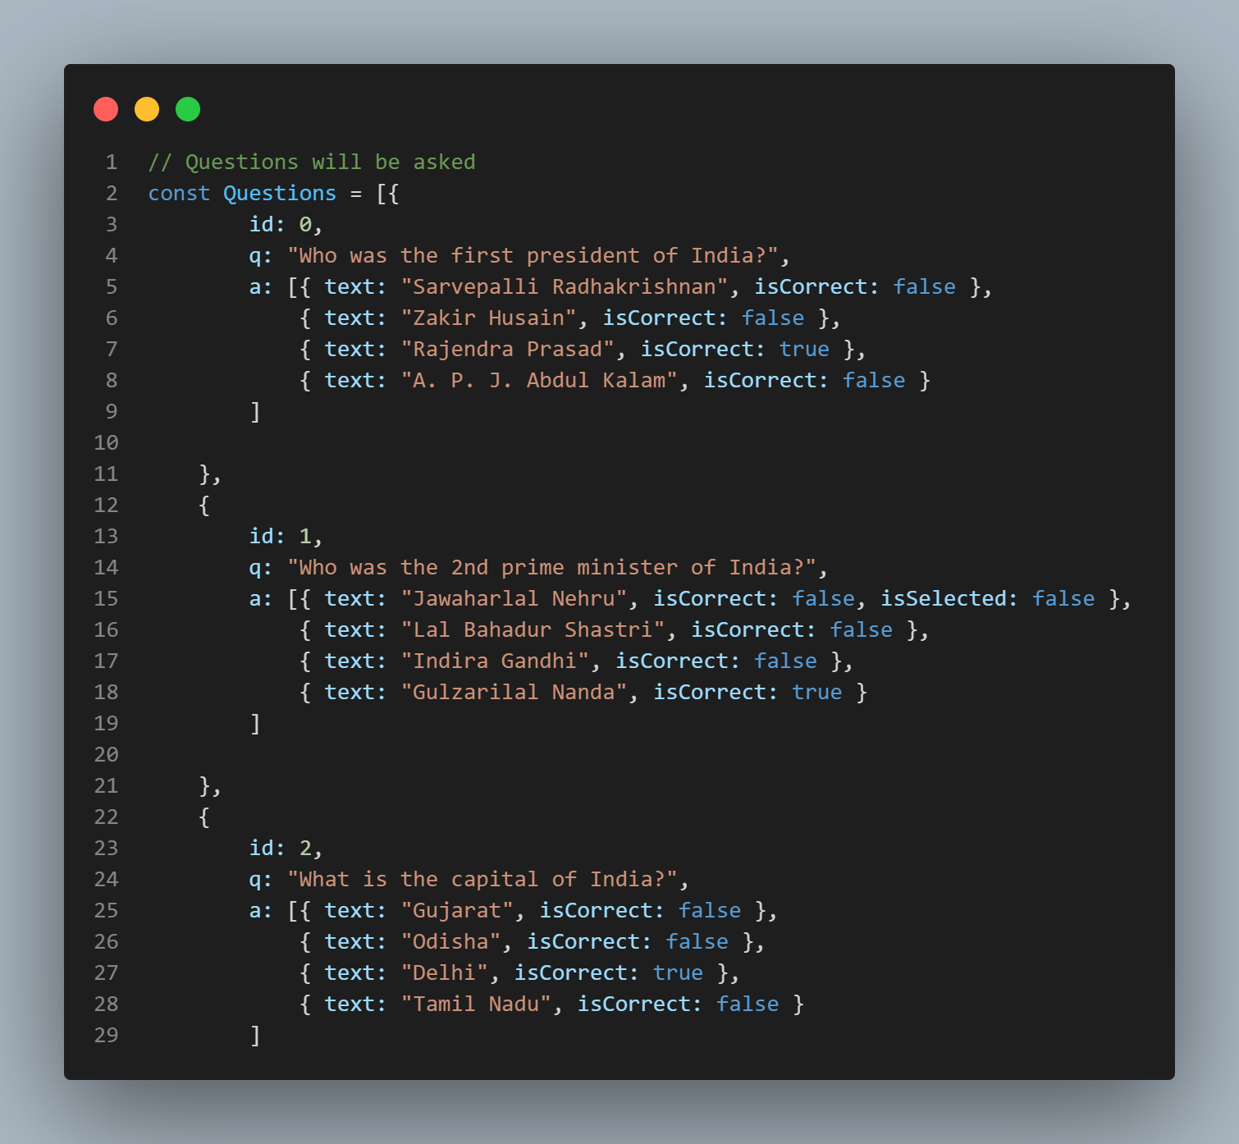
JAVA SCRIPT CODE

Slide 11

Summary and Future Work
HTML, CSS, and JavaScript are combined in this interactive quiz. JavaScript makes it interactive, while CSS adds visual appeal. Enhancements like timers, score tracking, and a database can improve the user experience.

Slide 12


